Slide 1

Mystry Box Fnd the answrs.
Mystry Box aims to use machine learning to take the guess work out of finding Spotify playlists and artist similar to you.

Slide 2
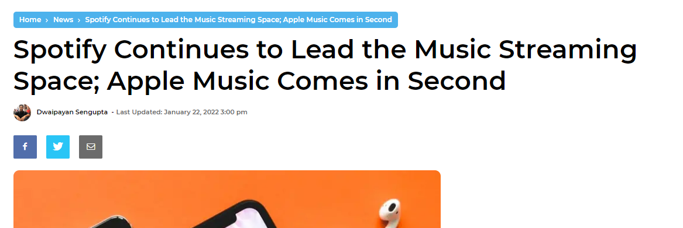
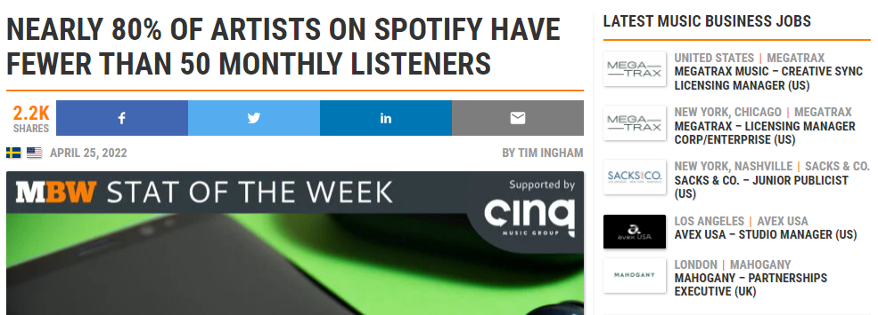
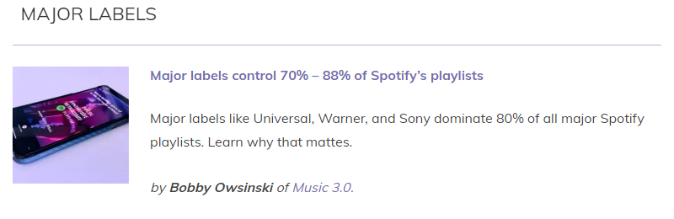

What answers are we trying to find?
How do I break into
the Spotify Top Tier?
Nearly 80% of artists on Spotify have less than 50 monthly listeners
Major labels control 70% – 88% of Spotify’s playlists - hypebot.com
Spotify holds a 31 percent market share in the music streaming industry. Apple Music, follows in second place with only a 15 percent market share. -BaseBorn.com

Slide 3
So what’s in the Box?

Slide 4




Mystry Box technologies
Easy to deploy
Easy to customize
Always learning

Slide 5
How to Fnd the answrs.
Danceability describes how suitable a track is for dancing based on a combination of musical elements including tempo, rhythm stability, beat strength, and overall regularity. A value of 0.0 is least danceable and 1.0 is most danceable.
Energy is a measure from 0.0 to 1.0 and represents a perceptual measure of intensity and activity. Typically, energetic tracks feel fast, loud, and noisy. For example, death metal has high energy, while a Bach prelude scores low on the scale. Perceptual features contributing to this attribute include dynamic range, perceived loudness, timbre, onset rate, and general entropy.
Valence is a measure from 0.0 to 1.0 describing the musical positiveness conveyed by a track. Tracks with high valence sound more positive (e.g. happy, cheerful, euphoric), while tracks with low valence sound more negative (e.g. sad, depressed, angry).
Speechiness detects the presence of spoken words in a track. The more exclusively speech-like the recording (e.g. talk show, audio book, poetry), the closer to 1.0 the attribute value. Values above 0.66 describe tracks that are probably made entirely of spoken words. Values between 0.33 and 0.66 describe tracks that may contain both music and speech, either in sections or layered, including such cases as rap music. Values below 0.33 most likely represent music and other non-speech-like tracks.

Slide 6
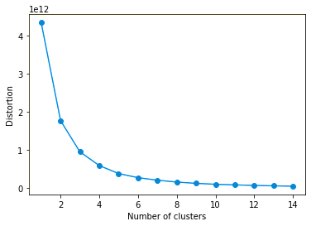
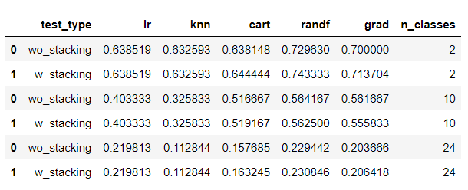






How to Fnd the answrs.

Slide 7
How Spotify does it
https://www.mygreatlearning.com/blog/how-spotify-uses-machine-learning-models/
1.Collaborative Filtering
On Spotify, the collaborative filtering algorithm compares multiple user-created playlists that have the songs that users have listened to. The algorithm then combs those playlists to look at other songs that appear in the playlists and recommends those songs.
2.Natural Language Processing
Spotify’s NLP constantly trawls the web to find articles, blog posts, or any other text about music, to come up with a profile for each song.
3.Convolutional Neural Networks
Each song is converted into a raw audio file as a waveform. These waveforms are processed by the CNN and is assigned key parameters such as beats per minute, loudness, major/minor key and so on. Spotify then tries to match similar songs that have the same parameters as the songs their listeners like listening to.

Slide 8



How to Fnd the answrs.

Slide 9
Mystry Box Future Updates.
Increase accuracy by training on a larger dataset
Provide more insight into the song metrics
Try and use clustering to create mood tags such as ‘chill’, ‘energetic’, etc..

Slide 10
Mystry Box Some good reads.
How Spotify Does It
Predicting my mood using my spotify data
Hyperparameter tuning RandomForest
Stacking Classifiers

